Slide 1

CSE 591 Dimensional Reduction
Ross Maciejewski
rmacieje@asu.edu

Slide 2
The Curse of Dimensionality
A term coined by Bellman in 1961
Refers to the problems associated with multivariate data analysis as the dimensionality increases the available data becomes sparse
Sparsity is a problem for any method that requires statistical significance
Sometimes data dimensions are redundant and can be reduced with minimal information loss
In visualization we are also limited with screen space and the number of available visual variables, so choosing the most appropriate dimensions is key
Richard Ernest Bellman; Rand Corporation (1957). Dynamic programming. Princeton University Press.

Slide 3
The Curse of Dimensionality
Let’s consider a simple 3-class pattern recognition problem
Feature space –the abstract space where each sample is represented as a point in n-dimensional space
S₁ = {x₁, x₂, … , x_{N}}
Simple approach is to divide the feature space into uniform bins, for our example start with one feature and divide the real line into 3 segments
Notice the overlap in our objects with regards to the chosen feature
f₁

Slide 4
The Curse of Dimensionality
Lets add another feature axis and explore
Now we start getting a relatively sparse scatterplot
Now imagine if we use our third dimension
f₂
f₁

Slide 5
The Curse of Dimensionality
Obviously dividing the sample space into equally spaced bins is inefficient, but it illustrates the problem
So, what can we do?
We can incorporate prior knowledge of the data
We can smooth the target function
We can reduce the dimensionality

Slide 6
The Practicality of the Curse of Dimensionality
For a given sample size, there is a maximum number of features above which the performance of classifying samples will degrade rather than improve
In most cases, the additional information that is lost when discarding some features is compensated by a more accurate mapping in the lower-dimensional space
So, how do we know what features we can throw away?
For visualization this implies that there are some features of a dataset that will be better to visualize (contain more information) than others!

Slide 7
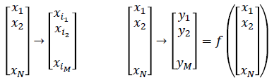
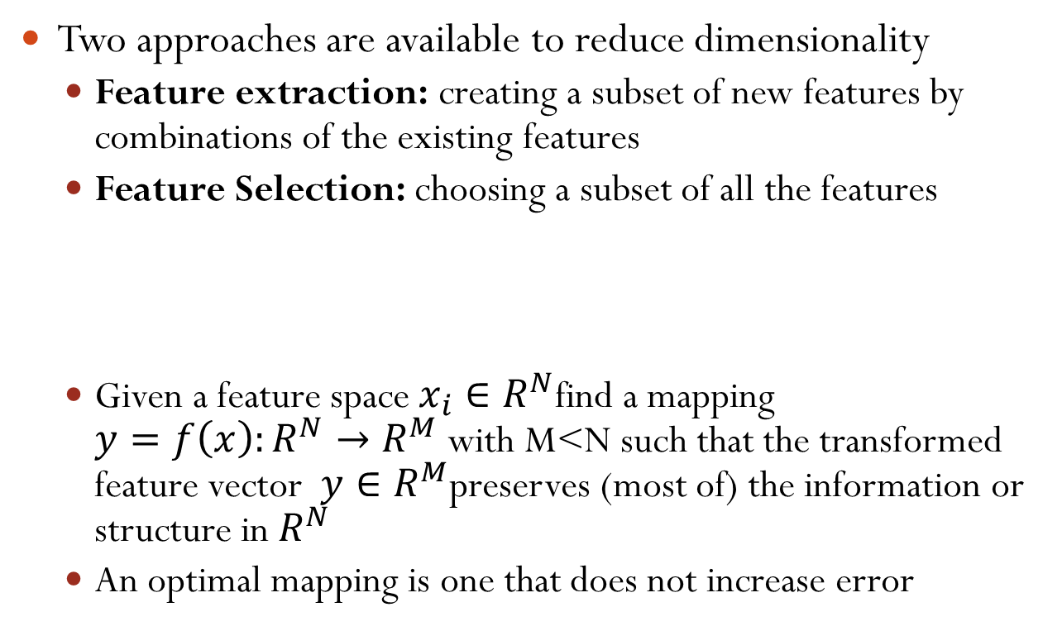
Dimensional Reduction
Two approaches are available to reduce dimensionality
Feature extraction: creating a subset of new features by combinations of the existing features
Feature Selection: choosing a subset of all the features
Given a feature space $x_{i}∈R^{N}$find a mapping $y=f\left(x\right):R^{N}→R^{M}$ with M<N such that the transformed feature vector $y∈R^{M}$preserves (most of) the information or structure in $R^{N}$
An optimal mapping is one that does not increase error

Slide 8
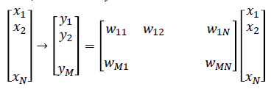
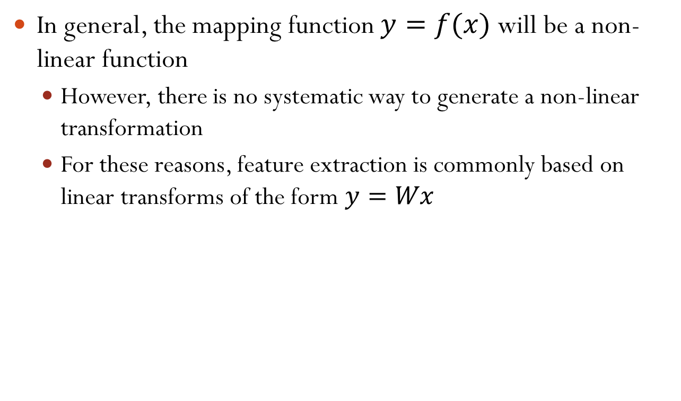
Linear Dimensionality Reduction
In general, the mapping function $y=f(x)$ will be a non-linear function
However, there is no systematic way to generate a non-linear transformation
For these reasons, feature extraction is commonly based on linear transforms of the form $y=Wx$

Slide 9
Principle Components Analysis
One of the most commonly applied dimension reduction techniques
PCA is a deterministic analytical procedure that utilizes an orthogonal transformation to reduce a set of sample observations with potentially correlated variables into a set of uncorrelated variables called principal components
The number of principal components will always be less than or equal to the original number of variables in the sample set
. T. Jolliffe, \Principal Component Analysis," Springer Series in Statistics, Springer, NY, 2002.

Slide 10


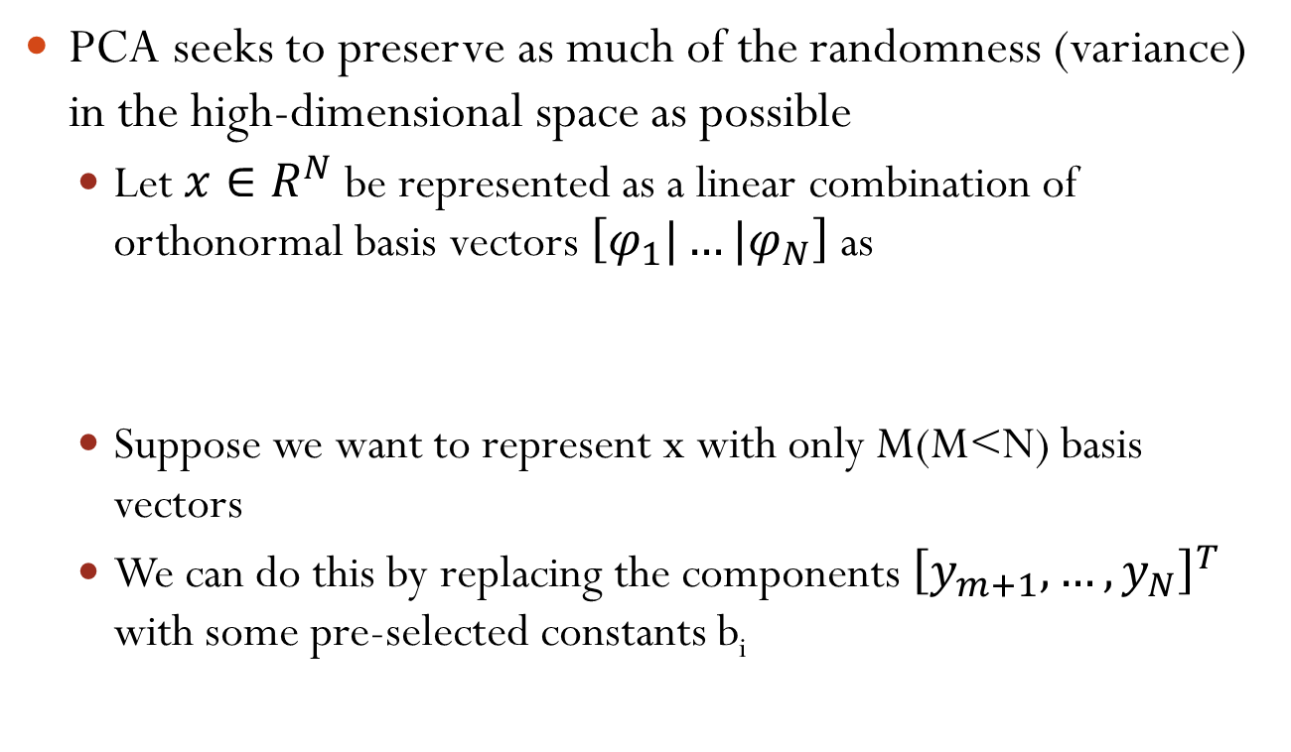
Principle Components Analysis
PCA seeks to preserve as much of the randomness (variance) in the high-dimensional space as possible
Let $x∈R^{N}$ be represented as a linear combination of orthonormal basis vectors $\left[φ_{1}|…|φ_{N}\right]$ as
Suppose we want to represent x with only M(M<N) basis vectors
We can do this by replacing the components ${\left[y_{m+1}, …,y_{N}\right]}^{T}$ with some pre-selected constants b_{i}

Slide 11

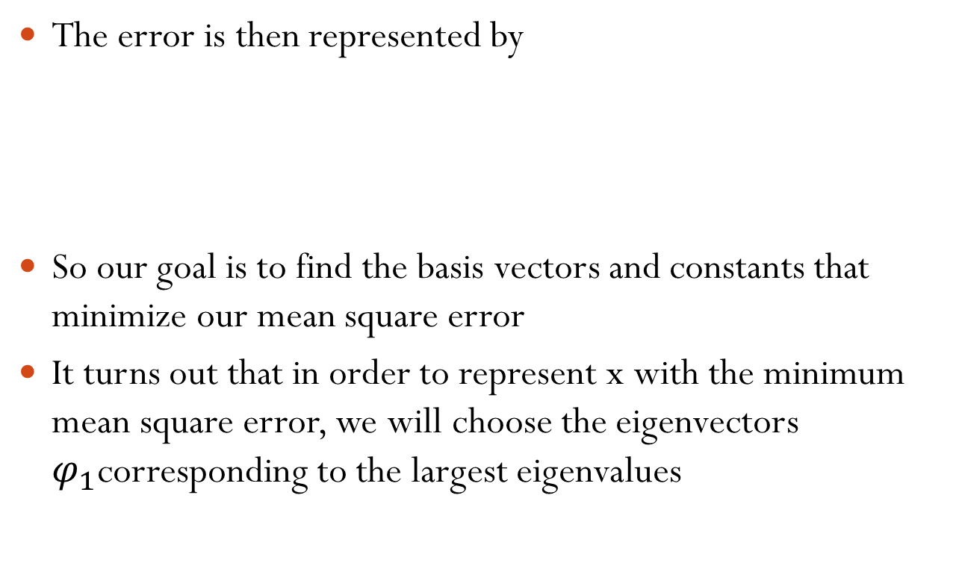
Principle Components Analysis
The error is then represented by
So our goal is to find the basis vectors and constants that minimize our mean square error
It turns out that in order to represent x with the minimum mean square error, we will choose the eigenvectors $φ_{1}$corresponding to the largest eigenvalues

Slide 12

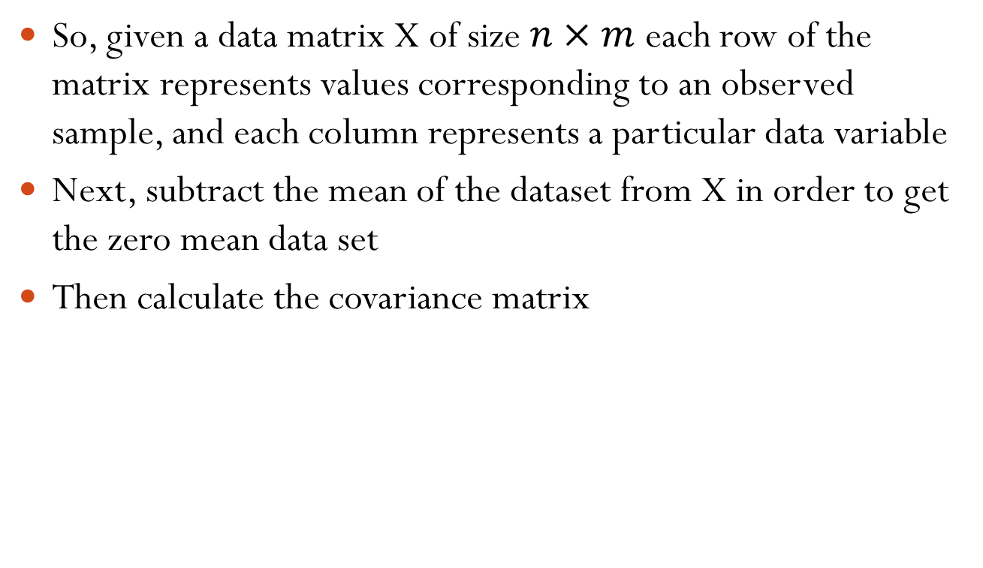
Principle Component Analysis
So, given a data matrix X of size $n×m$ each row of the matrix represents values corresponding to an observed sample, and each column represents a particular data variable
Next, subtract the mean of the dataset from X in order to get the zero mean data set
Then calculate the covariance matrix

Slide 13

Principle Component Analysis
Next find the eigenvectors of the covariance matrix
The eigenvectors are linearly independent and correspond to feature vectors of the data
Since PCA uses the eigenvectors of the covariance matrix, it is able to find the independent axes of the data under the unimodal Gaussian assumption
For non-Gaussian or multi-modal Gaussian, PCA simple de-correlates the axes

Slide 14
Principle Component Analysis
The main limitation of PCA is that it does not consider class separability since it does not take into account the class label of the feature vector
PCA simple performs a coordinate rotation that aligns the transformed axes with the directions of maximum variance
There is no guarantee that the directions of maximum variance will contain the most interesting/important features

Slide 15


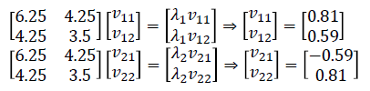
Example of PCA
Compute the PCA for :
X = {(1,2), (3,3), (3,5), (5,4), (5,6), (6,5), (8,7), (9,8)}
The sample covariance

Slide 16
Multi-Dimensional Scaling
In the classical multi-dimensional scaling scheme, the pairwise distances between observations is preserved in lower-dimensional projections
In this manner analysts can learn about differences in the high-dimensional space by viewing their relative distances in a two-dimensional projection
Details on MDS from: http://www.bristol.ac.uk/cmm/publications/aimdss-2nd-ed/chapter3.pdf

Slide 17
Multidimensional Scaling
Given a set of distances (dis-similarities) between objects, the goal is to recreate a dimensional representation of those objects
 | BOS | CHI | DC | DEN | LA | MIA | NY | SEA | SF
BOS | 0 | 963 | 429 | 1949 | 2979 | 1504 | 206 | 2976 | 3095
CHI | 963 | 0 | 671 | 996 | 2054 | 1329 | 802 | 2013 | 2142
DC | 429 | 671 | 0 | 1616 | 2631 | 1075 | 233 | 2684 | 2799
DEN | 1949 | 996 | 1616 | 0 | 1059 | 2037 | 1771 | 1307 | 1235
LA | 2979 | 2054 | 2631 | 1059 | 0 | 2687 | 2786 | 1131 | 379
MIA | 1504 | 1329 | 1075 | 2037 | 2687 | 0 | 1308 | 3273 | 3053
NY | 206 | 802 | 233 | 1771 | 2786 | 1308 | 0 | 2815 | 2934
SEA | 2976 | 2013 | 2684 | 1307 | 1131 | 3273 | 2815 | 0 | 808
SF | 3095 | 2142 | 2799 | 1235 | 379 | 3053 | 2934 | 808 | 0

Slide 18
Multidimensional Scaling
Using the dataset of distances between American cities, can we represent these cities in a two-dimensional space?
We could do this by trial and error, moving points about until we got the right distances
However, MDS will do this automatically for us
This problem is simplified in that there is no ambiguity in “distance”
Also, we know that the cities can be arranged in two dimensions

Slide 19
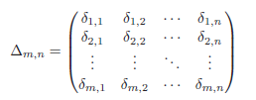
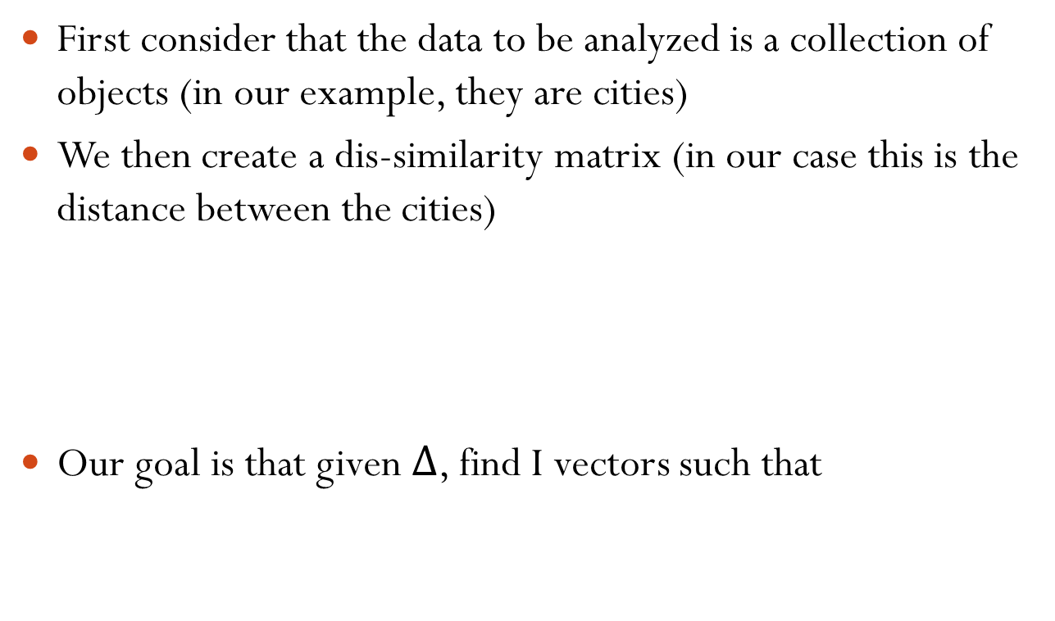
Multidimensional Scaling
First consider that the data to be analyzed is a collection of objects (in our example, they are cities)
We then create a dis-similarity matrix (in our case this is the distance between the cities)
Our goal is that given $∆$, find I vectors such that

Slide 20

Multidimensional Scaling
We formulate this as an optimization problem and can solve is doing eigenvalue decomposition
$$\min_{z}\sum{{\left(\left\|z_{i}−z_{j}\right\|−δ_{i,j}\right)}^{2}}$$

Slide 21
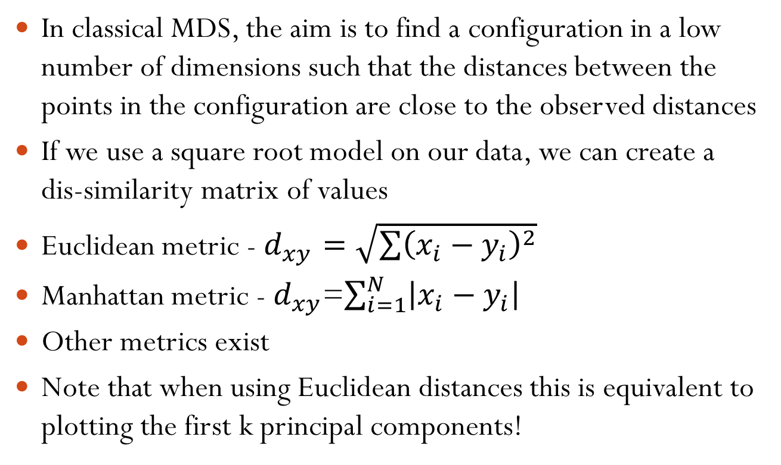
Classical Multidimensional Scaling
In classical MDS, the aim is to find a configuration in a low number of dimensions such that the distances between the points in the configuration are close to the observed distances
If we use a square root model on our data, we can create a dis-similarity matrix of values
Euclidean metric - $d_{xy}=\sqrt{\sum{{\left(x_{i}−y_{i}\right)}^{2}}}$
Manhattan metric - $d_{xy}$=$\sum_{i=1}^{N}{\left|x_{i}−y_{i}\right|}$
Other metrics exist
Note that when using Euclidean distances this is equivalent to plotting the first k principal components!

Slide 22
Clustering (introduction)
Clustering is a type of unsupervised machine learning
It is distinguished from supervised learning by the fact that there is not a priori output (i.e. no labels)
The task is to learn the classification/grouping from the data
A cluster is a collection of objects which are similar in some way
Clustering is the process of grouping similar objects into groups
Eg: a group of people clustered based on their height and weight
Normally, clusters are created using distance measures
Two or more objects belong to the same cluster if they are “close” according to a given distance (in this case geometrical distance like Euclidean or Manhattan)
Another measure is conceptual
Two or more objects belong to the same cluster if this one defines a concept common to all that objects
In other words, objects are grouped according to their fit to descriptive concepts, not according to simple similarity measures
Lecture 7 slides for CC282 Machine Learning, R. Palaniappan, 2008

Slide 23
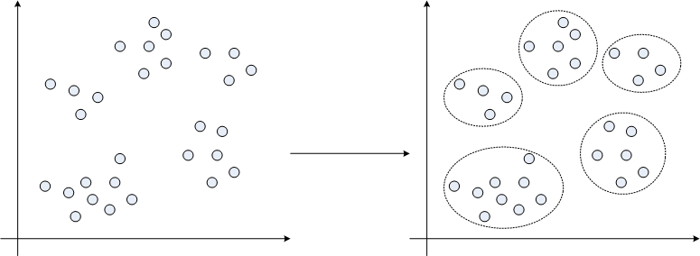
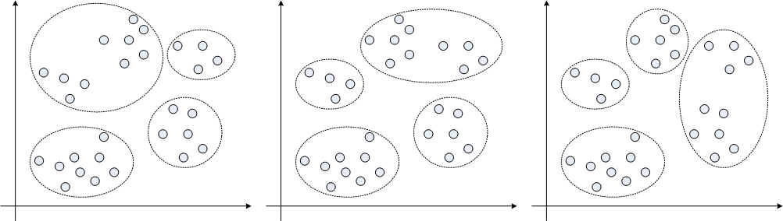
Clustering (introduction)
Example: using distance based clustering
This was easy but how if you had to create 4 clusters?
Some possibilities are shown below but which is correct?

Slide 24
Clustering (introduction – ctd)
So, the goal of clustering is to determine the intrinsic grouping in a set of unlabeled data
But how to decide what constitutes a good clustering?
It can be shown that there is no absolute “best” criterion which would be independent of the final aim of the clustering
Consequently, it is the user which must supply this criterion, to suit the application
Some possible applications of clustering
data reduction – reduce data that are homogeneous (similar)
find “natural clusters” and describe their unknown properties
find useful and suitable groupings
find unusual data objects (i.e. outlier detection)
Lecture 7 slides for CC282 Machine Learning, R. Palaniappan, 2008

Slide 25
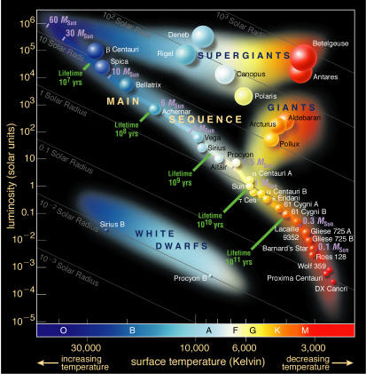
Clustering – an early application example
Hertzsprung-Russell diagram clustering stars by temperature and luminosity
Two astonomers in the early 20th century clustered stars into three groups using scatter plots
Main sequence: 80% of stars spending active life converting hydrogen to helium through nuclear fusion
Giants: Helium fusion or fusion stops: generates great deal of light
White dwarf: Core cools off
Diagram from Google Images
Lecture 7 slides for CC282 Machine Learning, R. Palaniappan, 2008

Slide 26
Clustering – Major approaches
Exclusive (partitioning)
Data are grouped in an exclusive way, one data can only belong to one cluster
Eg: K-means
Agglomerative
Every data is a cluster initially and iterative unions between the two nearest clusters reduces the number of clusters
Eg: Hierarchical clustering
Overlapping
Uses fuzzy sets to cluster data, so that each point may belong to two or more clusters with different degrees of membership
In this case, data will be associated to an appropriate membership value
Eg: Fuzzy C-Means
Probabilistic
Uses probability distribution measures to create the clusters
Eg: Gaussian mixture model clustering, which is a variant of K-means
Will not be discussed in this course
Lecture 7 slides for CC282 Machine Learning, R. Palaniappan, 2008

Slide 27
Exclusive (partitioning) clustering
Aim: Construct a partition of a database D of N objects into a set of K clusters
Method: Given a K, find a partition of K clusters that optimises the chosen partitioning criterion
K-means (MacQueen’67) is one of the commonly used clustering algorithm
It is a heuristic method where each cluster is represented by the centre of the cluster (i.e. the centroid)
Note: One and two dimensional (i.e. with one and two features) data are used in this lecture for simplicity of explanation
In general, clustering algorithms are used with much higher dimensions
Lecture 7 slides for CC282 Machine Learning, R. Palaniappan, 2008

Slide 28
K-means clustering algorithm
Lecture 7 slides for CC282 Machine Learning, R. Palaniappan, 2008
Given K, the K-means algorithm is implemented in four steps:
1. Choose K points at random as cluster centres (centroids)
2. Assign each instance to its closest cluster centre using certain distance measure (usually Euclidean or Manhattan)
3. Calculate the centroid of each cluster, use it as the new cluster centre (one measure of centroid is mean)
4. Go back to Step 2, stop when cluster centres do not change any more

Slide 29
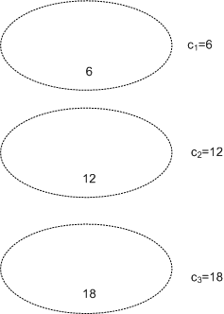
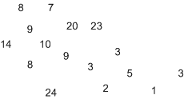
K-means – an example
Say, we have the data: {20, 3, 9, 10, 9, 3, 1, 8, 5, 3, 24, 2, 14, 7, 8, 23, 6, 12, 18} and we are asked to use K-means to cluster these data into 3 groups
Assume we use Manhattan distance*
Step one: Choose K points at random to be cluster centres
Say 6, 12, 18 are chosen
*note for one dimensional data, Manhattan distance=Euclidean distance
Lecture 7 slides for CC282 Machine Learning, R. Palaniappan, 2008

Slide 30
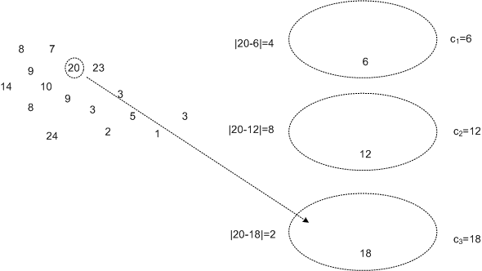
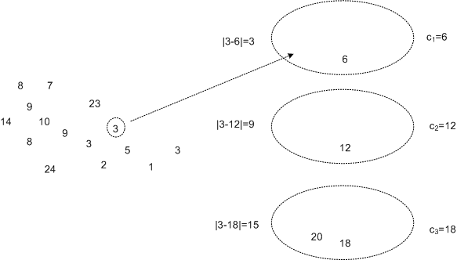
K-means – an example (ctd)
Step two: Assign each instance to its closest cluster centre using Manhattan distance
For instance:
20 is assigned to cluster 3
3 is assigned to cluster 1
Lecture 7 slides for CC282 Machine Learning, R. Palaniappan, 2008

Slide 31
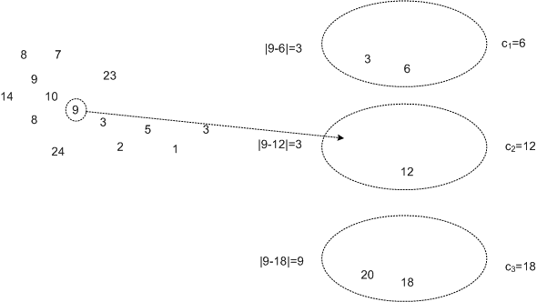
K-means – Example (ctd)
Step two continued: 9 can be assigned to cluster 1, 2 but let us say that it is arbitrarily assigned to cluster 2
Repeat for all the rest of the instances
Lecture 7 slides for CC282 Machine Learning, R. Palaniappan, 2008

Slide 32
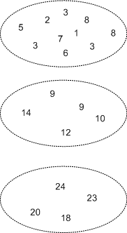
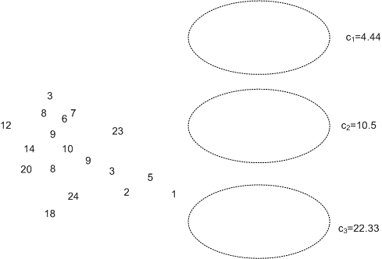
K-Means – Example (ctd)
And after exhausting all instances…
Step three: Calculate the centroid (i.e. mean) of each cluster, use it as the new cluster centre
End of iteration 1
Step four: Iterate (repeat steps 2 and 3) until the cluster centres do not change any more
Lecture 7 slides for CC282 Machine Learning, R. Palaniappan, 2008

Slide 33
K - means
Lecture 7 slides for CC282 Machine Learning, R. Palaniappan, 2008
Strengths
Relatively efficient: where N is no. objects, K is no. clusters, and T is no. iterations. Normally, K, T << N.
Procedure always terminates successfully (but see below)
Weaknesses
Does not necessarily find the most optimal configuration
Significantly sensitive to the initial randomly selected cluster centres
Applicable only when mean is defined (i.e. can be computed)
Need to specify K, the number of clusters, in advance

Slide 34
Local optimality
Distortion
Local minimum
Dist(C⁰)
Global minimum
Cluster set
C⁰ C¹ ..C^{n}
N.B: I’ve drawn the cluster set space as 1 dimensional for simplicity. In reality it is a very high dimensional space

Slide 35
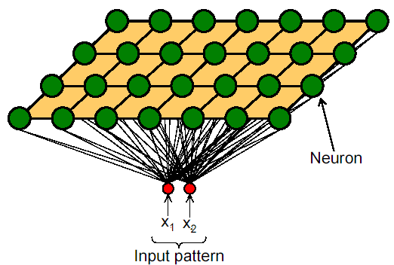
Kohonen SOM’s
The Self-Organizing Map (SOM) is an unsupervised artificial neural network algorithm. It is a compromise between biological modeling and statistical data processing
T. Kohonen, “The self-organizing map," Proceedings of the IEEE, pp. 1464-1480, 1986.
Notes:
There are many researchers who require biological plausibility in proposed neural network models especially since the aim of (most) networks is to emulate the brain. It is generally accepted that perceptrons, back-propagation and many other techniques are not biologically plausible.

Slide 36
Kohonen SOM’s
Each weight is representative of a certain input.
Input patterns are shown to all neurons simultaneously.
Competitive learning: the neuron with the largest response is chosen.
Notes:
There are many researchers who require biological plausibility in proposed neural network models especially since the aim of (most) networks is to emulate the brain. It is generally accepted that perceptrons, back-propagation and many other techniques are not biologically plausible.

Slide 37
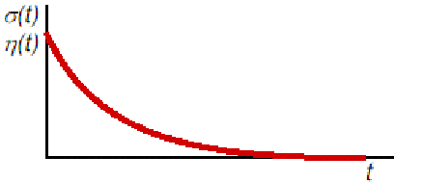
Kohonen SOM’s
Initialize weights
Repeat until convergence
Select next input pattern
Find Best Matching Unit
Update weights of winner and neighbours
Decrease learning rate & neighbourhood size
Learning rate & neighbourhood size

Slide 38
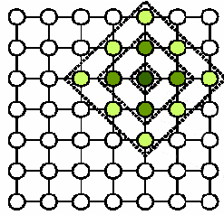
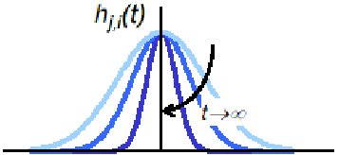
Kohonen SOM’s
Distance related learning

Slide 39
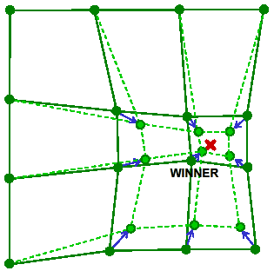
Kohonen SOM’s

Slide 40
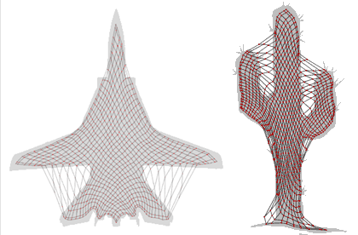
Some nice illustrations

Slide 41
Readings and Homework
Required Reading:
Alex Endert, Chao Han, Dipayan Maiti, Leanna House, Scotland Leman, Chris North: Observation-level interaction with Statistical models for visual analytics. IEEE VAST 2011: 121-130
Jaegul Choo, Hanseung Lee, Jaeyeon Kihm, Haesun Park: iVisClassifier: An interactive visual analytics system for classification based on supervised dimension reduction. IEEE VAST 2010: 27-34

Slide 42
Questions?

